Slide 1
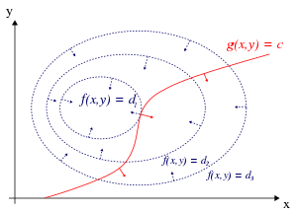
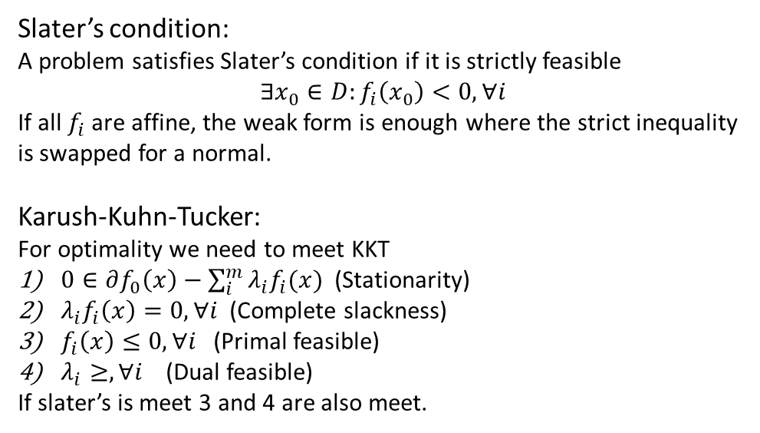
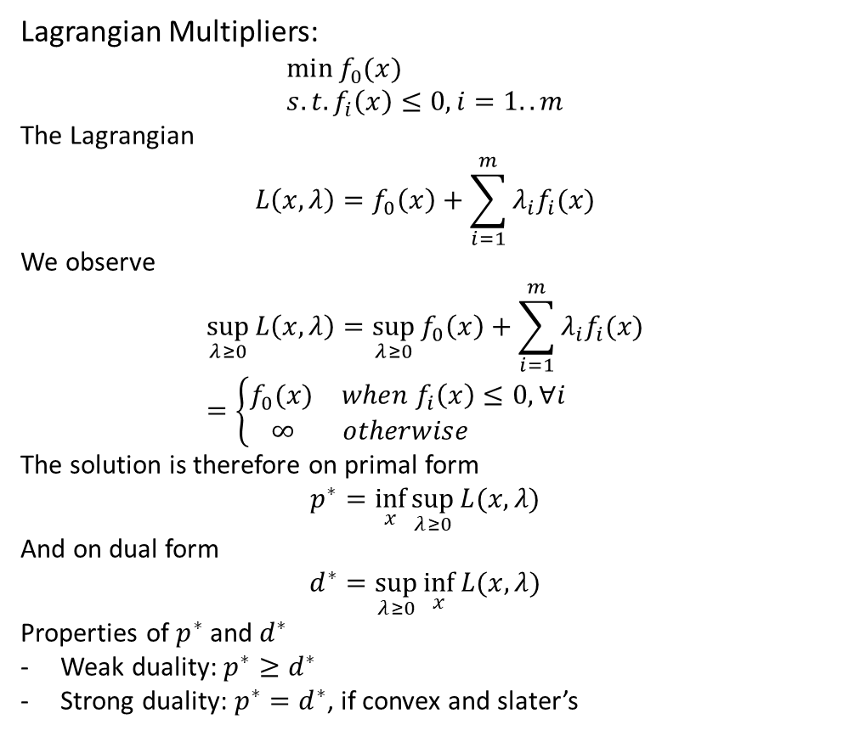
Lecture 7
Lagrangian Multipliers:
$$\min{f_{0}(x)} \\ s.t. f_{i}\left(x\right)≤0, i=1..m$$
The Lagrangian
$$L\left(x,λ\right)=f_{0}\left(x\right)+\sum_{i=1}^{m}{λ_{i}f_{i}(x)}$$
We observe
$$\sup_{λ≥0}{L\left(x,λ\right)=\sup_{λ≥0}{f_{0}\left(x\right)+\sum_{i=1}^{m}{λ_{i}f_{i}(x)}}} \\ =\left\{\begin{aligned}\begin{matrix}f_{0}(x) & when f_{i}\left(x\right)≤0, ∀i\end{matrix} \\ \begin{matrix}∞ & otherwise \end{matrix}\end{aligned}\right.$$
The solution is therefore on primal form
$$p^{∗}=\inf_{x}{\sup_{λ≥0}{L(x,λ)}}$$
And on dual form
$$d^{∗}=\sup_{λ≥0}{\inf_{x}{L(x,λ)}}$$
Properties of $p^{∗}$ and $d^{∗}$
Weak duality: $p^{∗}≥d^{∗}$
Strong duality: $p^{∗}=d^{∗}$, if convex and slater’s
Slater’s condition:
A problem satisfies Slater’s condition if it is strictly feasible
$$∃x_{0}∈D:f_{i}\left(x_{0}\right)<0, ∀i$$
If all $f_{i}$ are affine, the weak form is enough where the strict inequality is swapped for a normal.
Karush-Kuhn-Tucker:
For optimality we need to meet KKT
$0∈∂f_{0}\left(x\right)−\sum_{i}^{m}{λ_{i}f_{i}(x)}$ (Stationarity)
$λ_{i}f_{i}\left(x\right)=0, ∀i$(Complete slackness)
$f_{i}\left(x\right)≤0, ∀i$(Primal feasible)
$λ_{i}≥, ∀i$ (Dual feasible)
If slater’s is meet 3 and 4 are also meet.

Slide 2
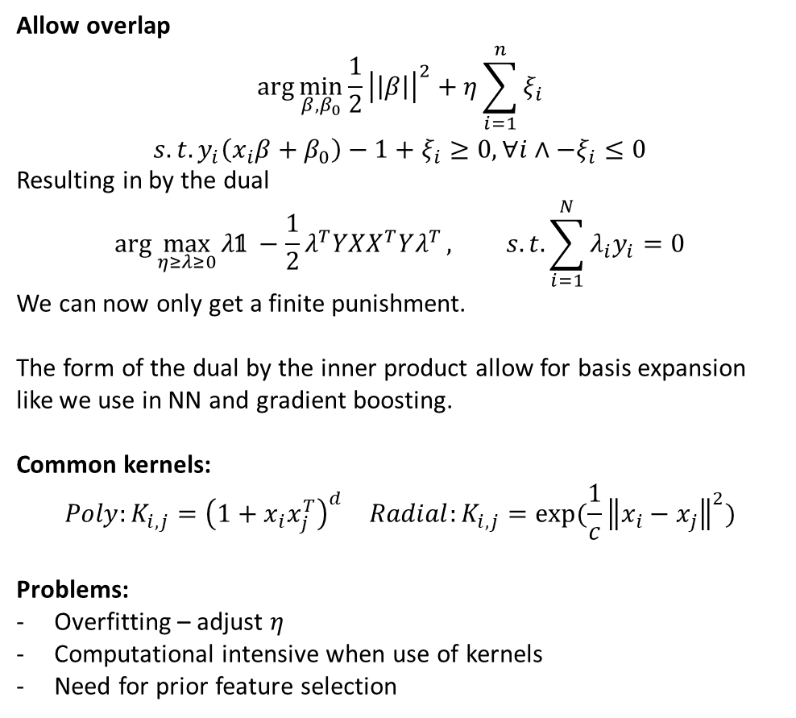
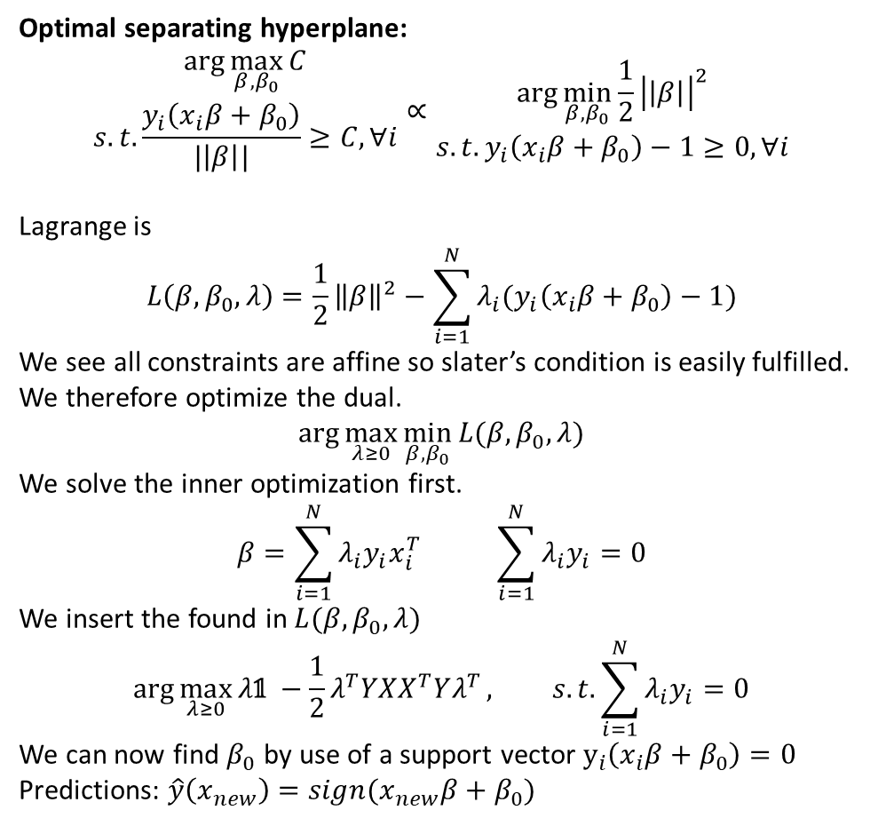
Lecture 7
Optimal separating hyperplane:
$$\begin{matrix}\arg{\max_{β,β_{0}}{C}} \\ s.t.\frac{y_{i}\left(x_{i}β+β_{0}\right)}{|\left|β\right||}≥C, ∀i\end{matrix}∝\begin{matrix}\arg{\min_{β,β_{0}}{\frac{1}{2}{\left|\left|β\right|\right|}^{2}}} \\ s.t. y_{i}\left(x_{i}β+β_{0}\right)−1≥0, ∀i\end{matrix}$$
Lagrange is
$$L\left(β,β_{0},λ\right)=\frac{1}{2}{\left\|β\right\|}^{2}−\sum_{i=1}^{N}{λ_{i}(y_{i}\left(x_{i}β+β_{0}\right)−1)}$$
We see all constraints are affine so slater’s condition is easily fulfilled.
We therefore optimize the dual.
$$\arg{\max_{λ≥0}{\min_{β,β_{0}}{L(β,β_{0},λ)}}}$$
We solve the inner optimization first.
$$β=\sum_{i=1}^{N}{λ_{i}y_{i}x_{i}^{T}} \sum_{i=1}^{N}{λ_{i}y_{i}}=0$$
We insert the found in $L(β,β_{0},λ)$
$$\arg{\max_{λ≥0}{λ\text{𝟙} −\frac{1}{2}λ^{T}YXX^{T}Yλ^{T}}}, s.t.\sum_{i=1}^{N}{λ_{i}y_{i}}=0$$
We can now find $β_{0}$ by use of a support vector $y_{i}\left(x_{i}β+β_{0}\right)=0$
Predictions: $\hat{y}\left(x_{new}\right)=sign(x_{new}β+β_{0})$
Allow overlap
$$\begin{matrix}\arg{\min_{β,β_{0}}{\frac{1}{2}{\left|\left|β\right|\right|}^{2}}}+η\sum_{i=1}^{n}{ξ_{i}} \\ s.t. y_{i}\left(x_{i}β+β_{0}\right)−1+ξ_{i}≥0, ∀i∧−ξ_{i}≤0\end{matrix}$$
Resulting in by the dual
$$\arg{\max_{η≥λ≥0}{λ\text{𝟙} −\frac{1}{2}λ^{T}YXX^{T}Yλ^{T}}}, s.t.\sum_{i=1}^{N}{λ_{i}y_{i}}=0$$
We can now only get a finite punishment.
The form of the dual by the inner product allow for basis expansion like we use in NN and gradient boosting.
Common kernels:
$$\begin{matrix}Poly:K_{i,j}={\left(1+x_{i}x_{j}^{T}\right)}^{d} & Radial:K_{i,j}=exp⁡(\frac{1}{c}{\left\|x_{i}−x_{j}\right\|}^{2})\end{matrix}$$
Problems:
Overfitting – adjust $η$
Computational intensive when use of kernels
Need for prior feature selection

